Slide 1
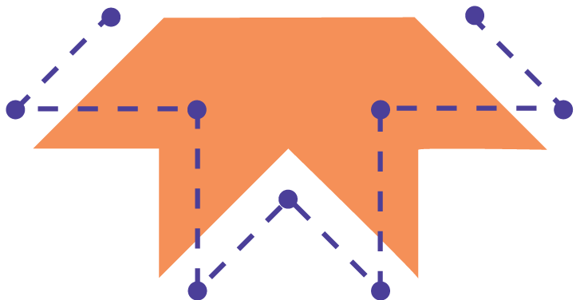
welcome to
Session 2
Let’s All Play on the Playground:
Circuit Playground Express Practice
Notes:
Facilitator Guide - Day 2 - Meal Time

Slide 2
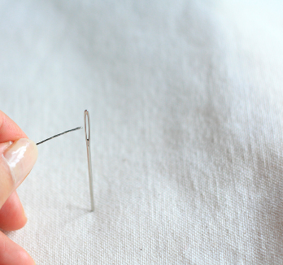
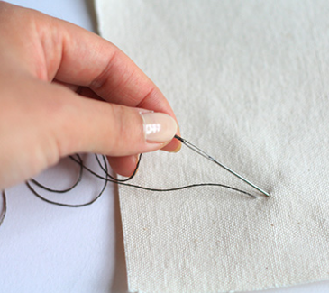
1
4
Thread the needle
Use a needle-threader or a magnifying glass to help
Pull the thread through the fabric
The knot you made at the end will catch on the back of the fabric (this way, your knot is hidden on the back)
Tie a knot near the end of the long tail
This will stop the thread from coming through the fabric
Push your needle back through the fabric about ¼” away
This time, you’re pushing the needle from the front of the fabric to the back
2
5
Poke the needle through the fabric
Push it from back to front of your fabric
You made a stitch!
Repeat this by pushing your needle through the back and front of the fabric.
Keep each stitch about ¼” apart
3
6
Notes:
Facilitator Guide - Day 2 - Meal Time

Slide 3
Storytelling
Notes:
Facilitator Guide - Day 1 - Welcome & Sharing - What is an E-Textile?

Slide 4
What places are important to your family?
Think about all sorts of different places:
Where is your family from?
Where do you like to go together?
Where is your home?
Where do you gather with family and friends?
Where do your meaningful stories take place?
Is there a room, building, or natural space that is special?
Notes:
Facilitator Guide - Day 2 - Welcome & Sharing - Project Prompt Brainstorm
See Family Guide “Sheet 1”

Slide 5
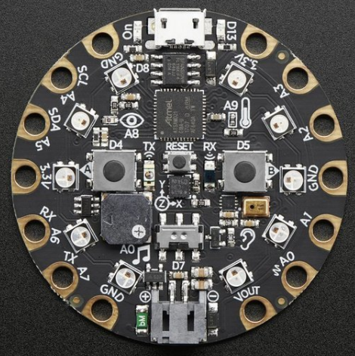
Circuit Playground Express (CPX)
GND
3.3V
3.3V
GND
GND
Notes:
Facilitator Guide - Day 2 - Exploring - CPX as a Simple Circuit

Slide 6
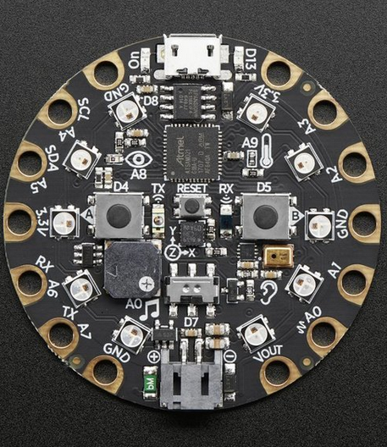
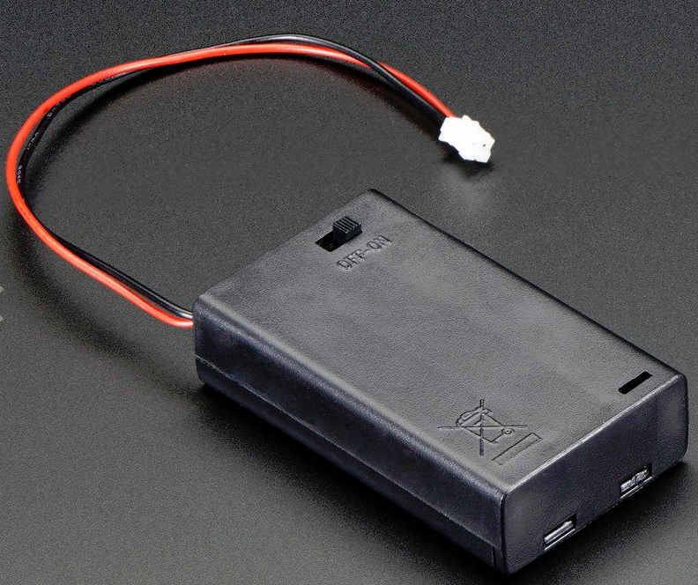
Circuit Playground Express (CPX)
Power on a small LED with alligator clips, similar to how we used the circuit blocks
Notes:
Facilitator Guide - Day 2 - Exploring - CPX as a Simple Circuit

Slide 7
Circuit Playground Express (CPX)
The CPX is a microcontroller
a microcontroller
is like a
“Brain” icon by Clockwise from the Noun Project.
Notes:
Facilitator Guide - Day 2 - Exploring - Introducing CPX as a Microcontroller

Slide 8
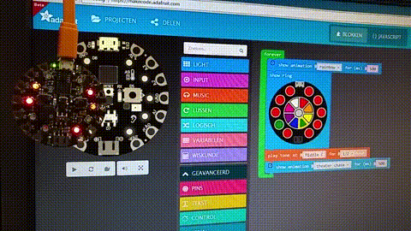
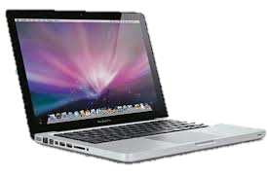
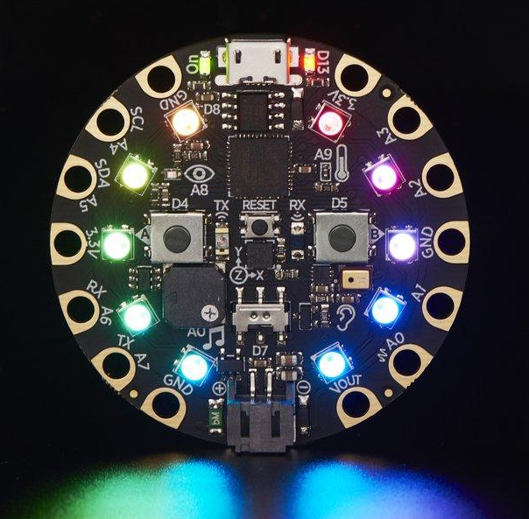
Circuit Playground Express (CPX)
Program
(MakeCode)
Storage
(on CPX & computer)
Inputs
(sensors,
switches)
Runs a Process
(on CPX)
Outputs
(lights, sounds)

Slide 9
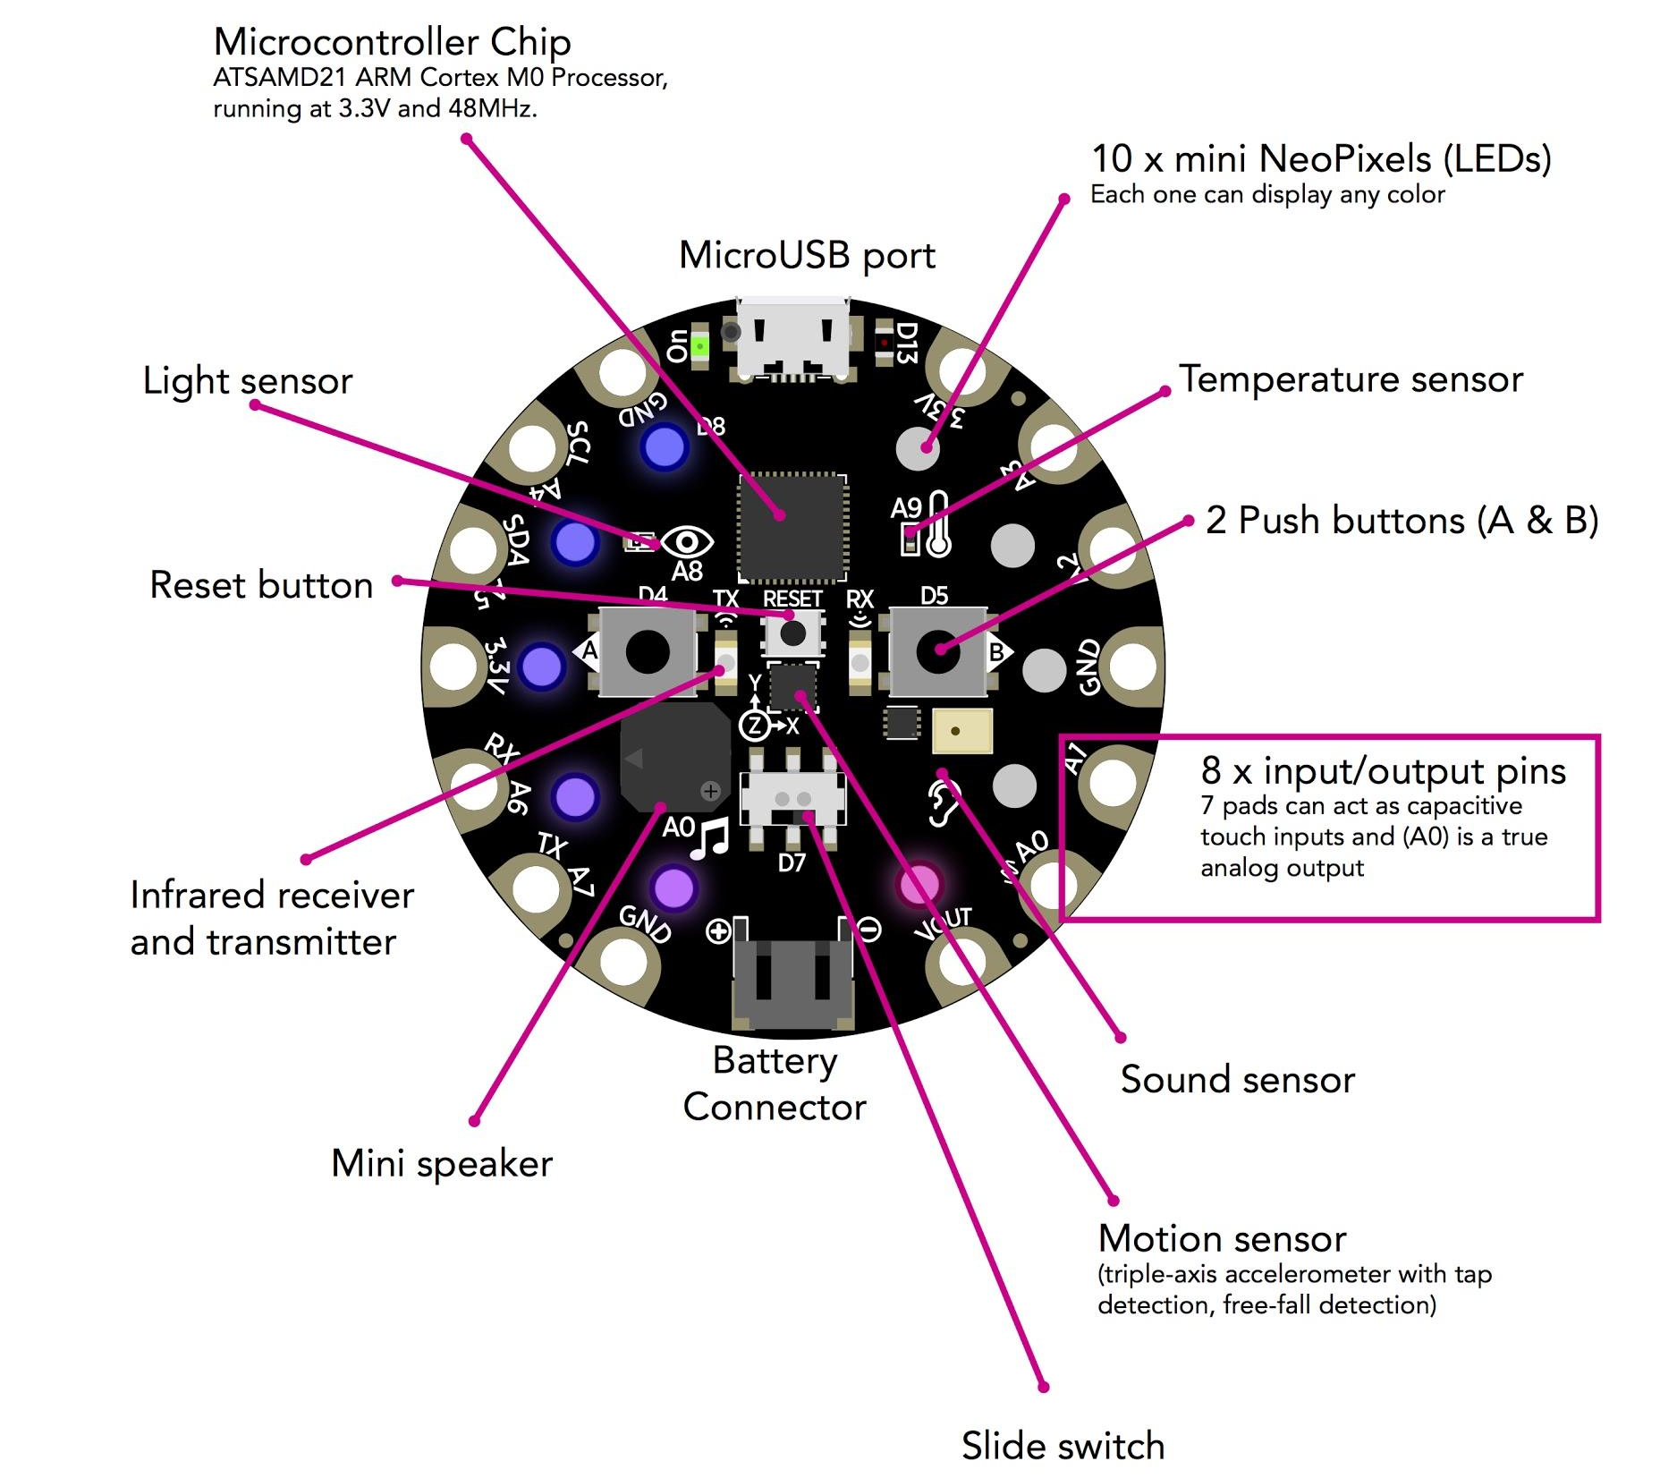
Circuit Playground Express (CPX)
Notes:
Facilitator Guide - Day 2 - Exploring - Introducing CPX as a Microcontroller

Slide 10
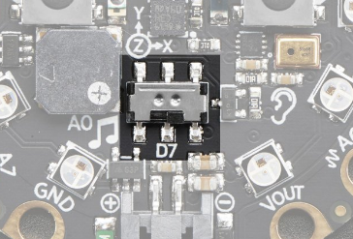
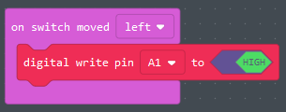
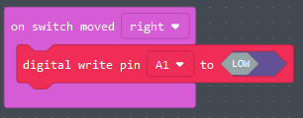
Circuit Playground Express (CPX)
Single Slide Switch
Notes:
Facilitator Guide - Day 2 - Exploring - Introducing CPX as a Microcontroller

Slide 11
Circuit Playground Express (CPX)
Notes:
Facilitator Guide - Day 2 - Exploring - CPX as a Simple Circuit

Slide 12
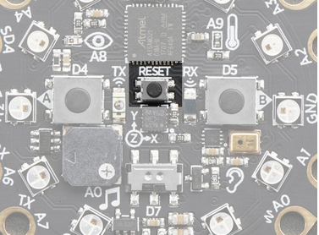
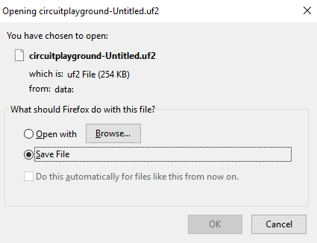
Circuit Playground Express (CPX)
Downloading Your Code
1
4
Locate your Downloads Folder
Find your file (.uf2)
ex:
2
5
3
6
Locate
and drag your file onto it
Your code is transferred!
Notes:
Facilitator Guide - Day 2 - Exploring - Introducing CPX as a Microcontroller

Slide 13
Free Play on the CPX
TRY THIS:
Control the Neopixels
Use an Animation for the light ring
Use a Button to Trigger a Light or Sound
Use ‘Shake’ to Trigger a Light or Sound
Touch a Pin to Trigger a Light or Sound
Notes:
Facilitator Guide - Day 2 - Exploring - Free Play on the Playground

Slide 14
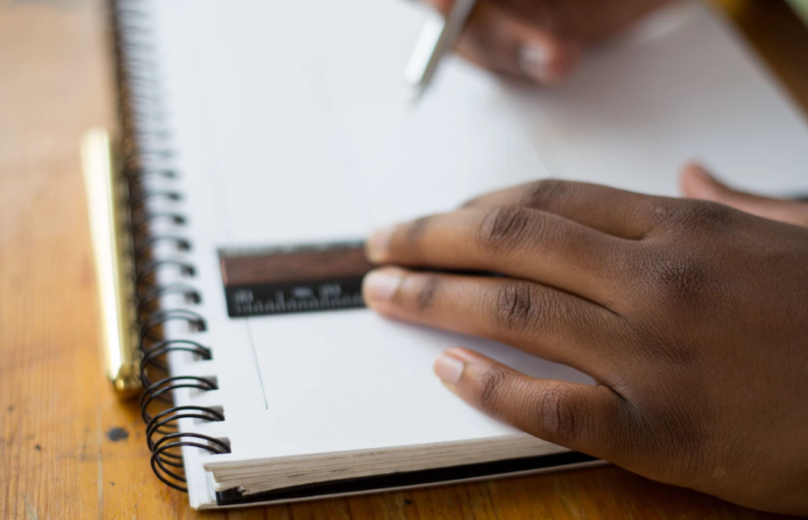
Project
Sketch
Photo by Tamarcus Brown on Unsplash
Notes:
Facilitator Guide - Day 2 - Storytelling - Project Sketch

Slide 15
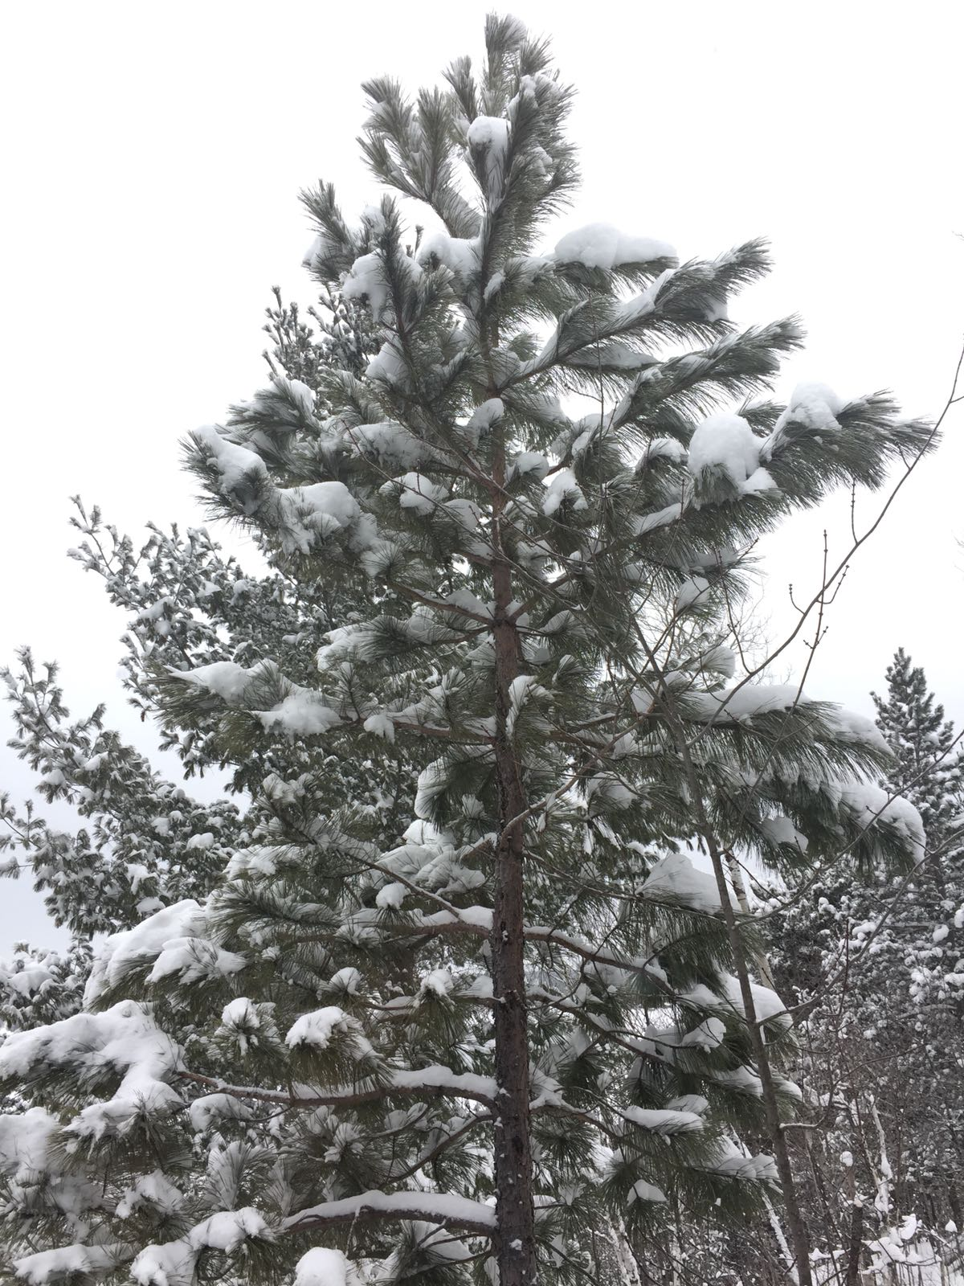
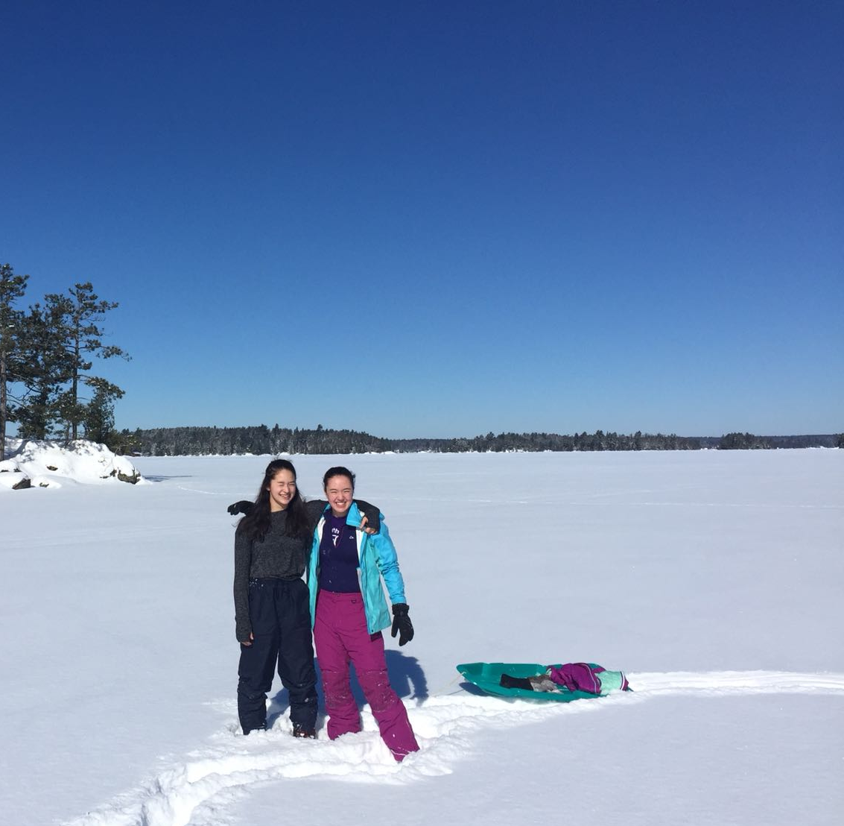
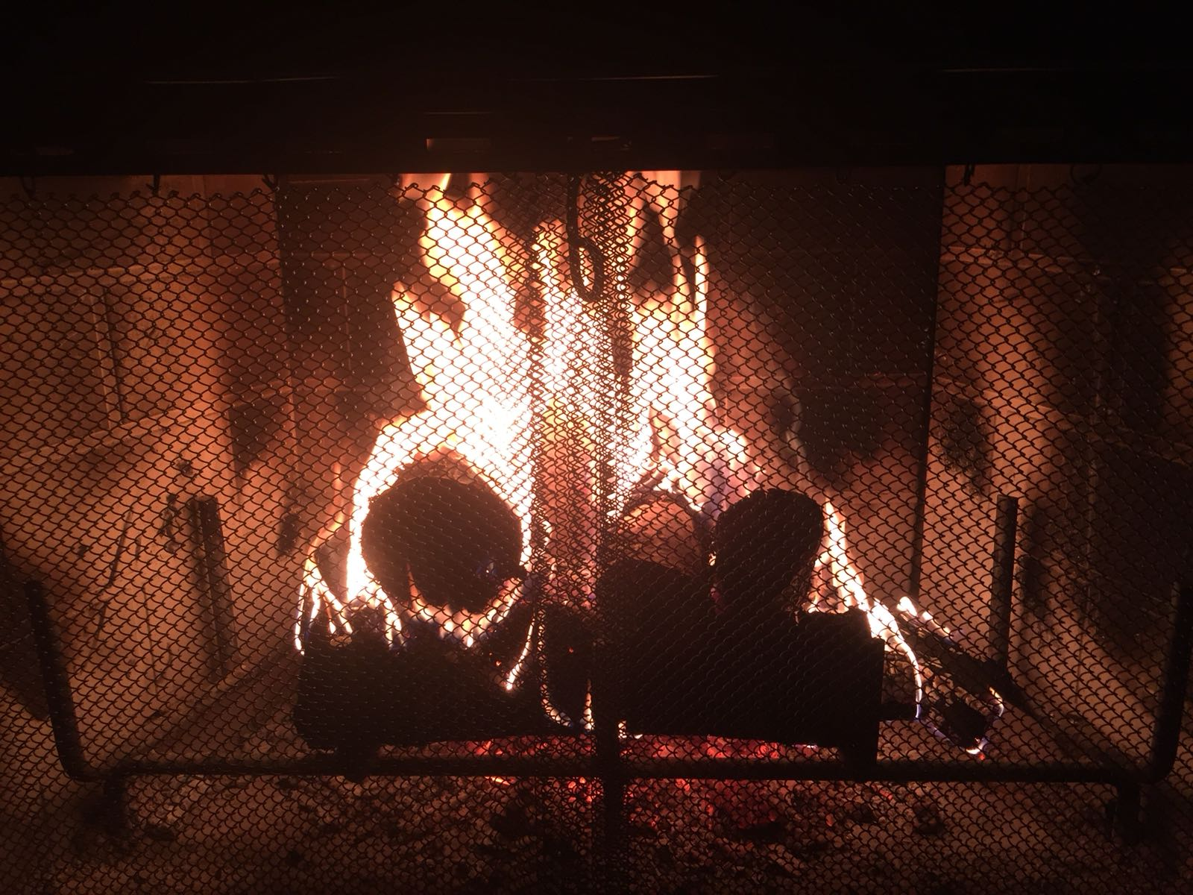
Cabin in the Woods
E-Textiles - Family Project Example
Our family loves to visit the north woods of Minnesota.
In the winter, we read by the fire, walk on the frozen lake to find deer trails, and watch the snow fall and land on the trees.
In the summer, we fish and swim in the lake, hike, and listen to the wind through the trees.
In this place, we feel connected to the land and peaceful.
.
Notes:
Facilitator Guide - Day 2 - Storytelling - Project Sketch

Slide 16
Create a project
based on a place that is important to your family.
What are your experiences in this place?
What makes this place important to you?
What do you smell there?
What do you feel there?
What do you see there?
What do you do when you’re there?
Notes:
Facilitator Guide - Day 2 - Storytelling - Project Sketch

Slide 17
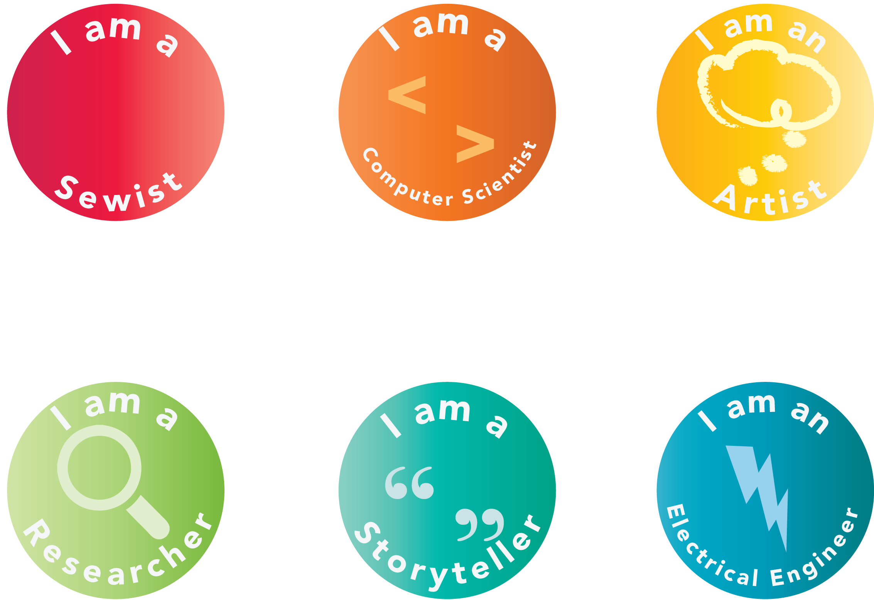
What kind of thinking did you do today?
Badges
Notes:
Facilitator Guide - Day 2 - Acknowledging - Badges, Survey, Clean-Up

